Slide 1
Capstone Project - Enhancing Linux Endpoint Security with Wazuh:
Unauthorized Process Detection and Malicious IP Blocking
Tasks 1 and 2
Presented by: Akpevweoghene Ememu

Slide 2
Task 1 Overview
Objective: Detect unauthorized Netcat usage
Approach: Wazuh command monitoring
Detection: Custom rules for Netcat process alerts

Slide 3
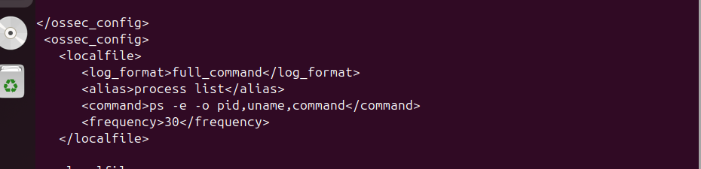
Wazuh Agent Configuration
Added config to ossec.conf using /var/ossec/etc/ossec.conf file
Restarted Wazuh agent

Slide 4
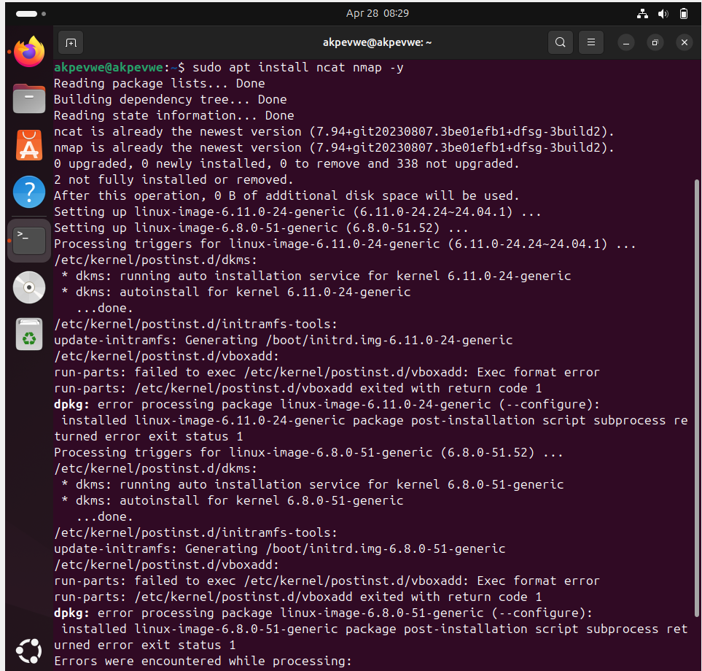
Netcat Installation and Wazuh Rule
Installed ncat and nmap
Custom rules to detect nc –l

Slide 5
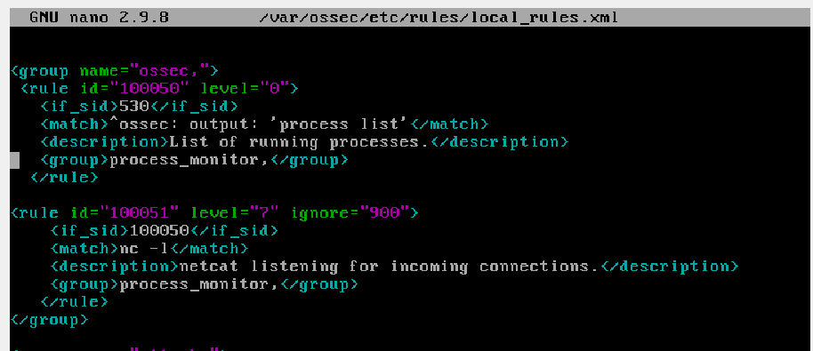
Netcat Installation and Wazuh Rule
Inputted custom rules to detect nc –l
Added the following rules to the /var/ossec/etc/rules/local_rules.xml file on the Wazuh server

Slide 6
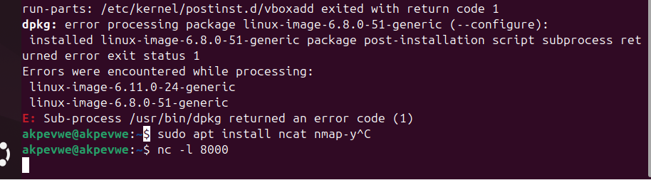
Attack Emulation
Ran nc -l 8000
Alerts triggered: rule.id (100051)

Slide 7
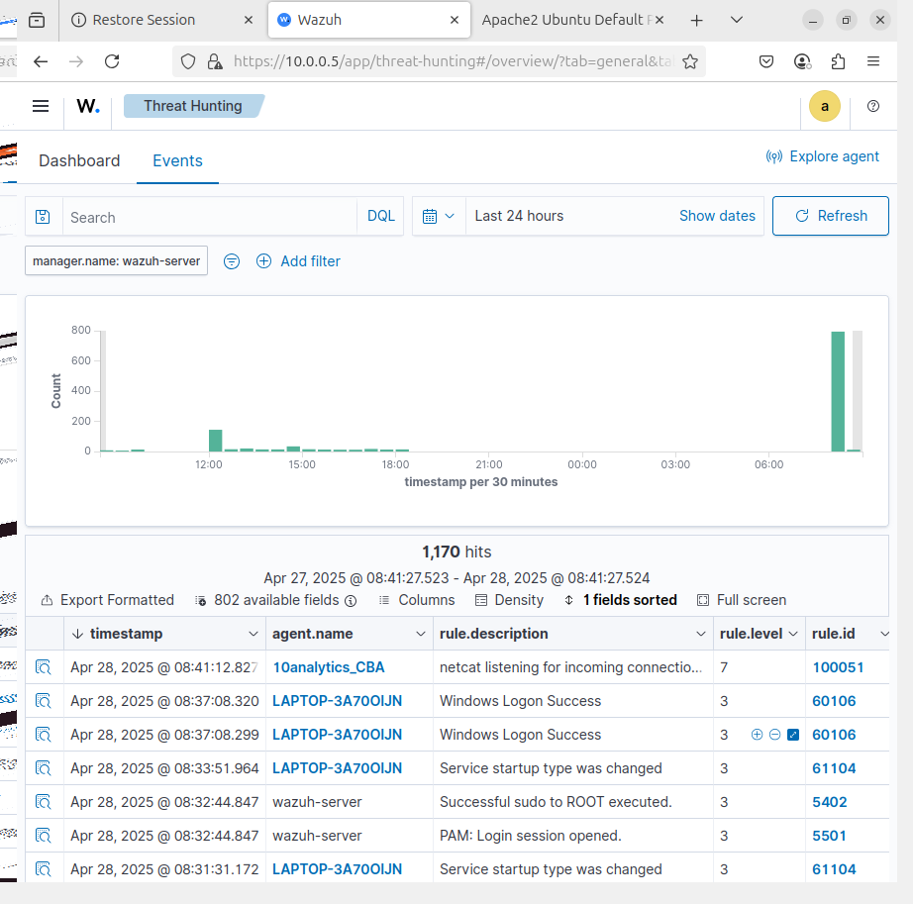
Visualisation of Alerts
I visualized the alert data in the Wazuh dashboard by going to the Threat Hunting
module to obtain rule.id:(100051)

Slide 8
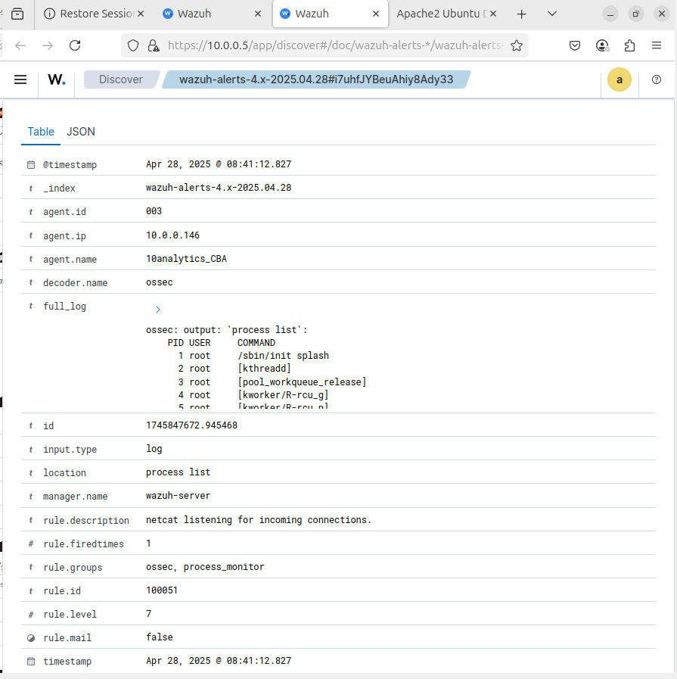
Visualisation of Alerts
Details of rule.id (100051)

Slide 9
Mitigation Strategies for Netcat
Usage rules for authorised persons
Limit installation
Detect behavior
Track commands
Network monitoring
Secure alternatives

Slide 10
Task 2 Overview
Objective: Block malicious IPs
Environment: Wazuh, Ubuntu server & RHEL attacker(Kali)

Slide 11
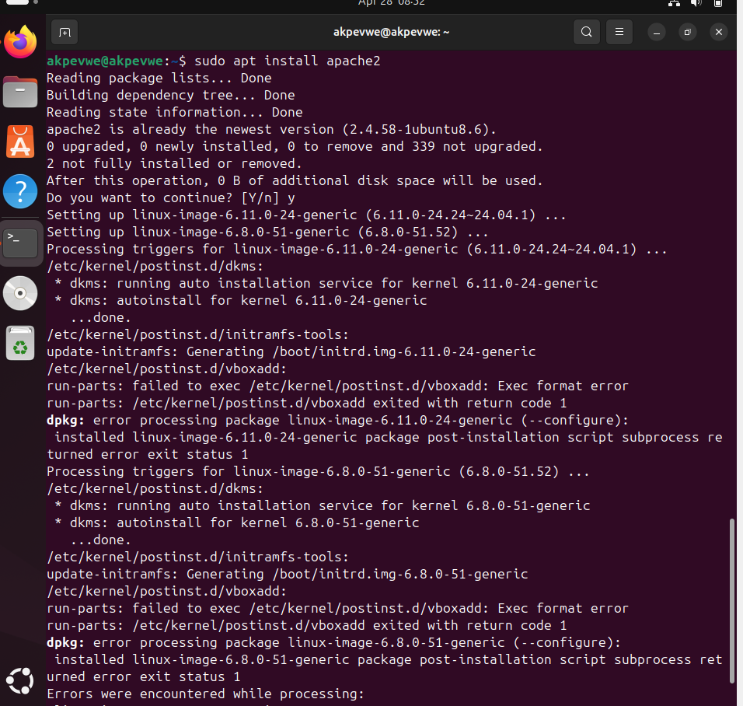
Apache Setup and Monitoring
Installed Apache
Monitored access.log with Wazuh

Slide 12
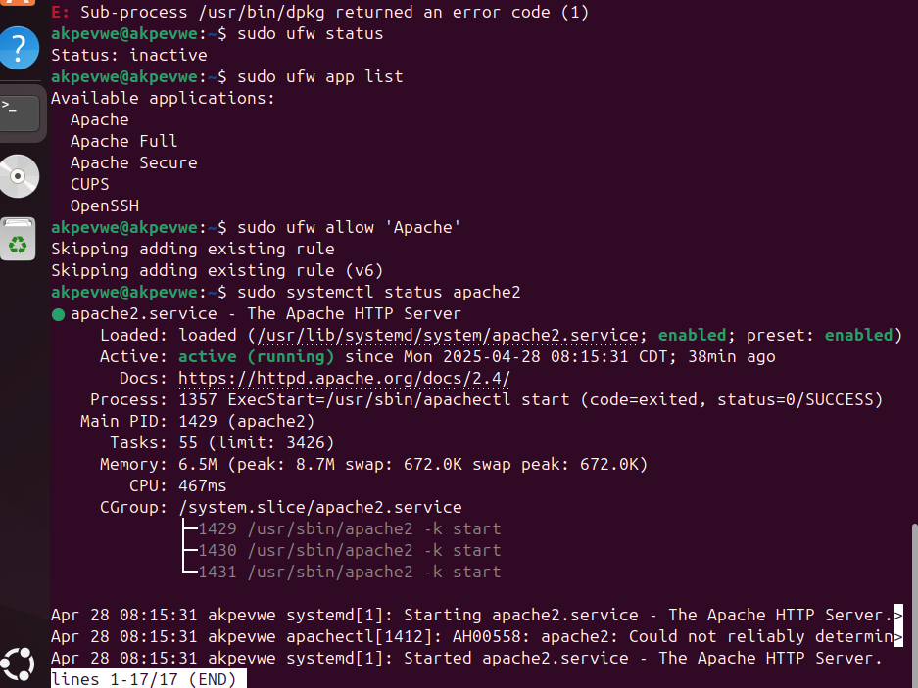
Apache Setup and Monitoring
Installed Apache
Monitored access.log with Wazuh

Slide 13
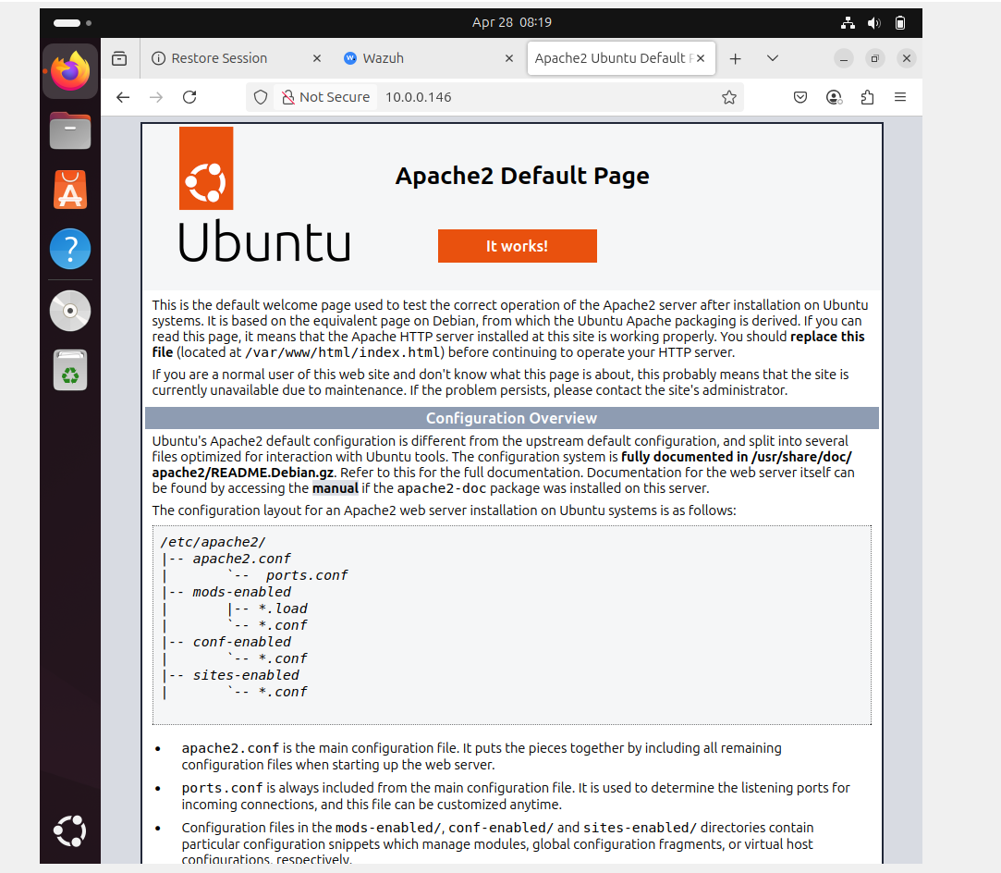
Apache Setup and Monitoring
Use the curl command $ curl http://10.0.0.146
in a browser to view the Apache landing page and verify the installation:

Slide 14
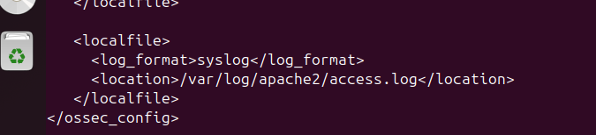
Apache Setup and Monitoring
Add the following to /var/ossec/etc/ossec.conf file to configure the Wazuh

Slide 15
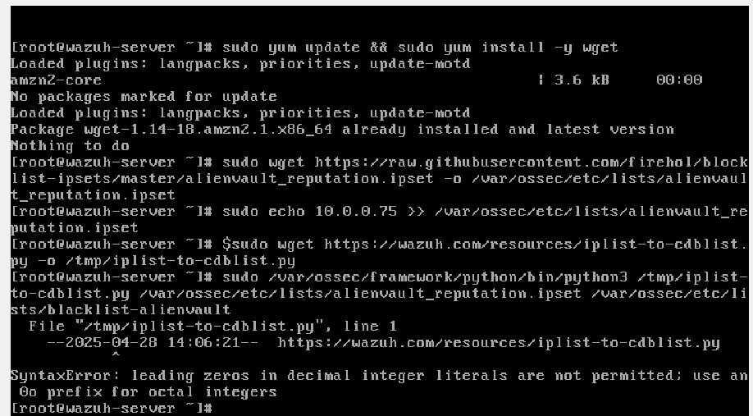
Wazuh Server Configuration
Downloaded IP list
Converted to .cdb
Updated permissions

Slide 16
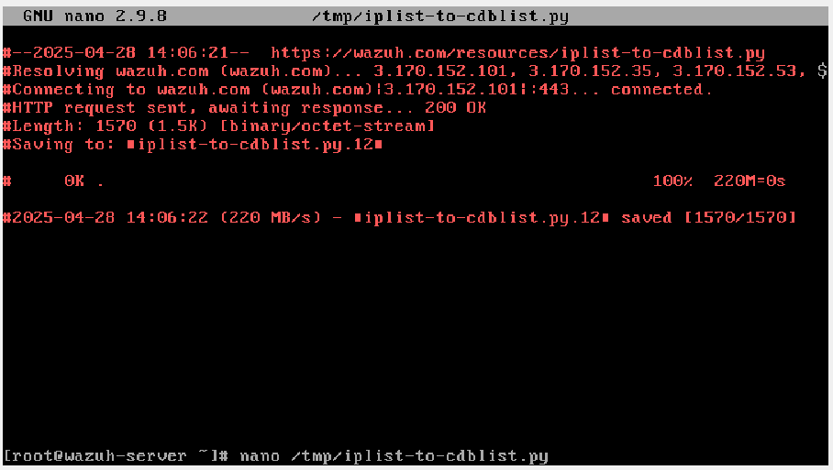
Wazuh Server Configuration
Downloaded IP list
Converted to .cdb
Updated permissions

Slide 17
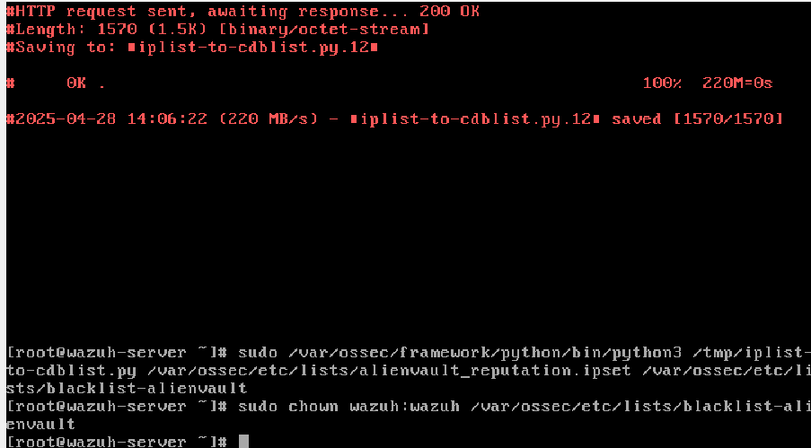
Wazuh Server Configuration

Slide 18
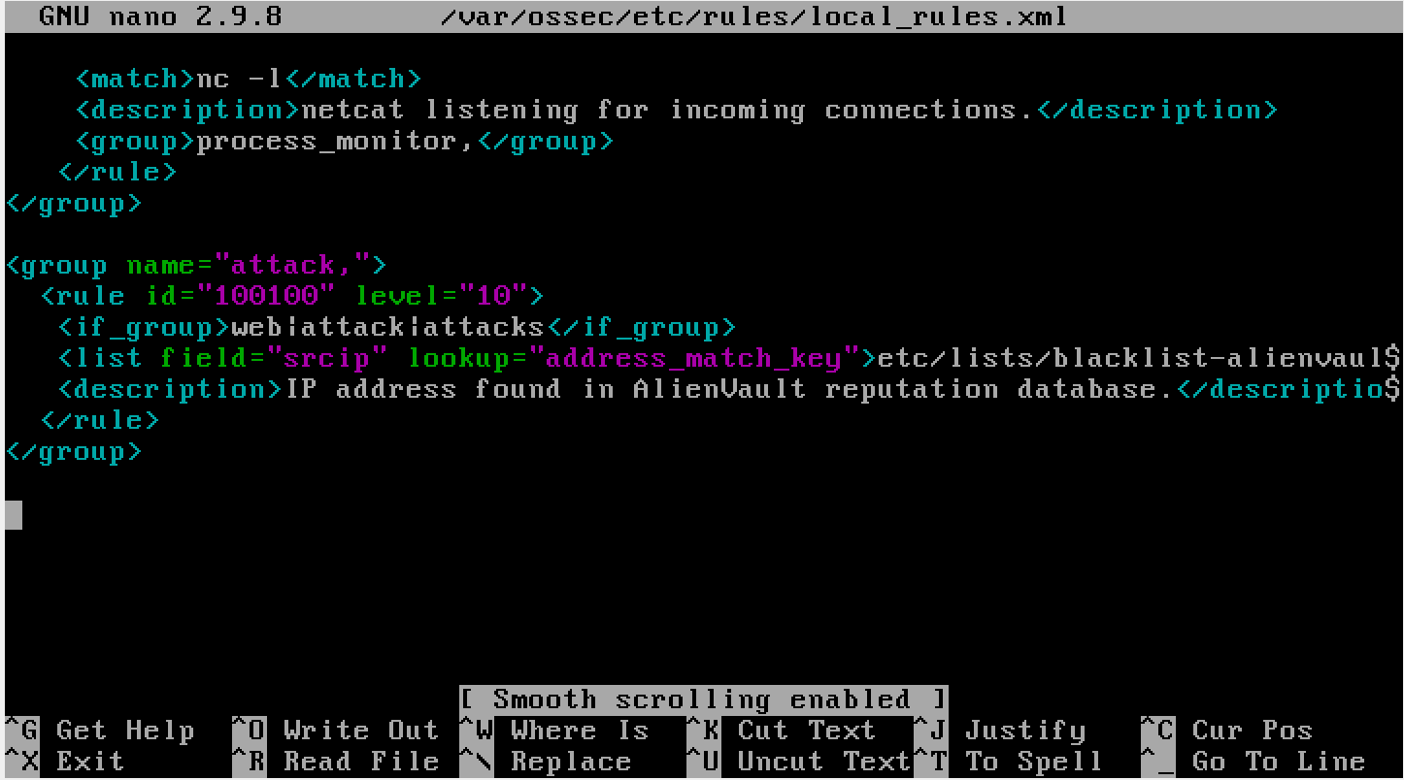
Custom Rules and Active Response
Match IPs
Active response: firewall-drop
Restarted manager

Slide 19
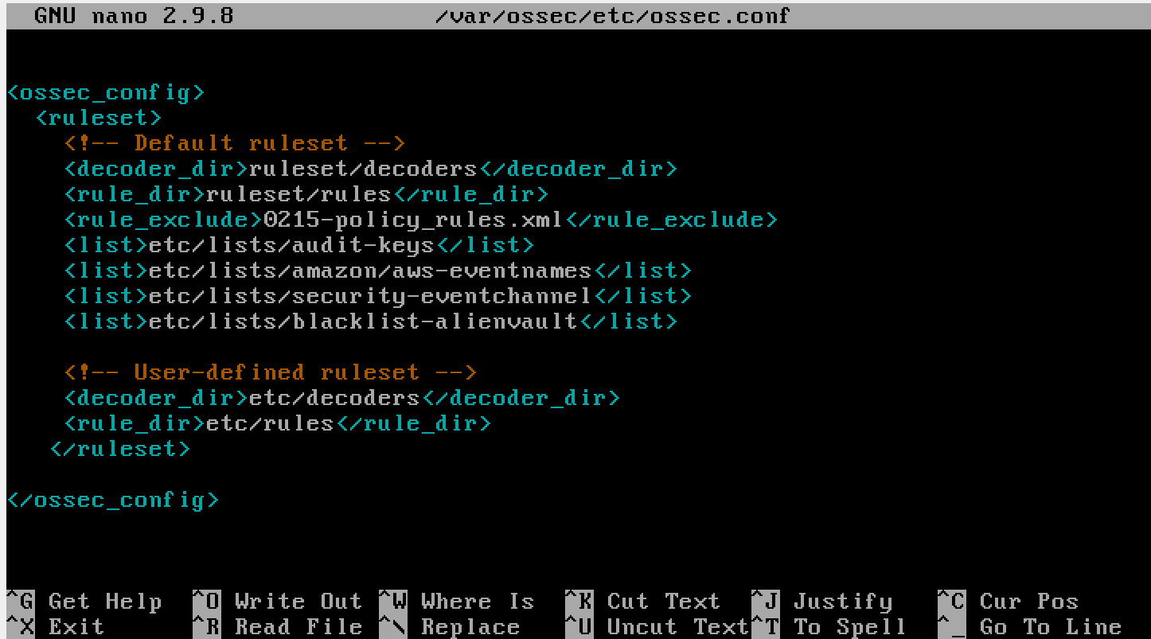
Custom Rules and Active Response
Active response: firewall-drop

Slide 20
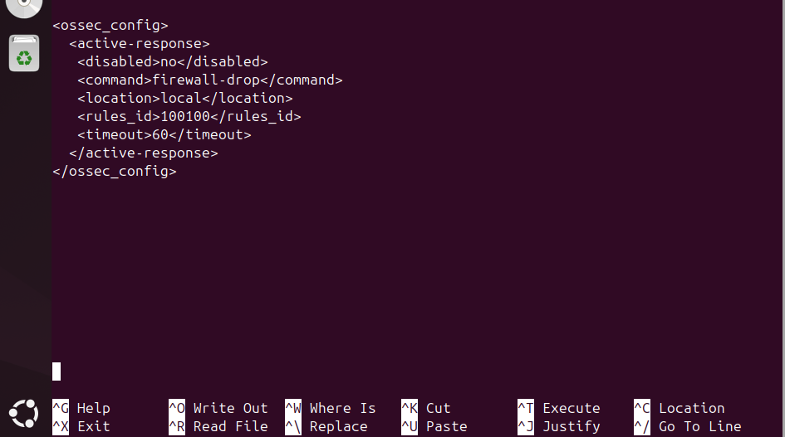
Custom Rules and Active Response
Active response: firewall-drop

Slide 21
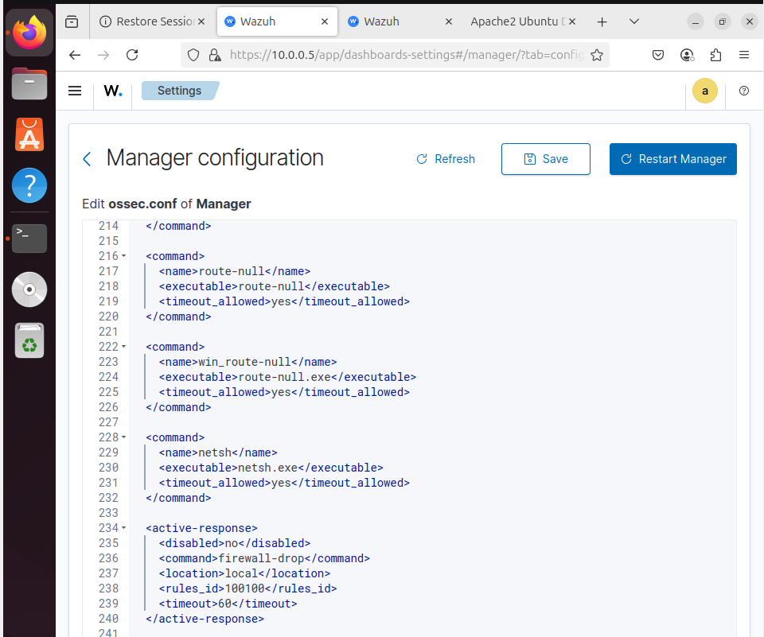

Custom Rules and Active Response
Active response: firewall-drop

Slide 22
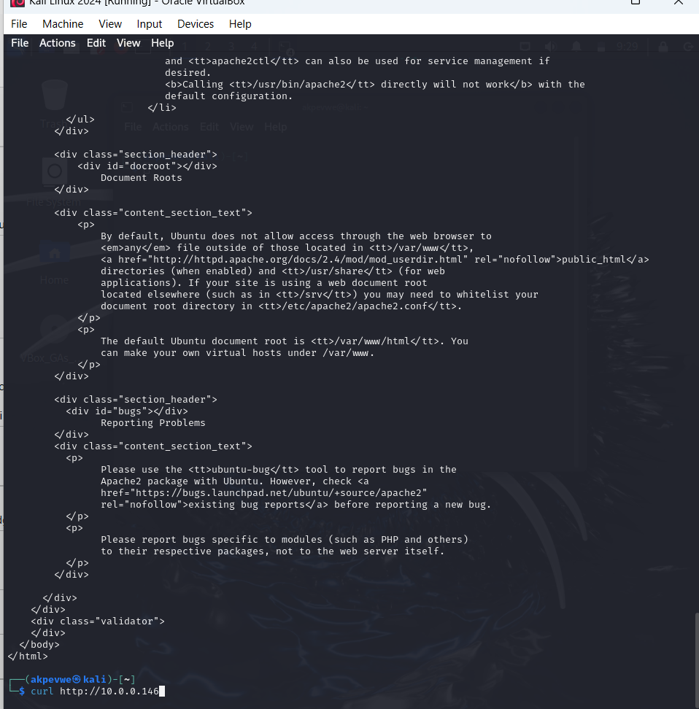
Attack Emulation
Ran command $ curl http://10.0.0.146 on kali

Slide 23
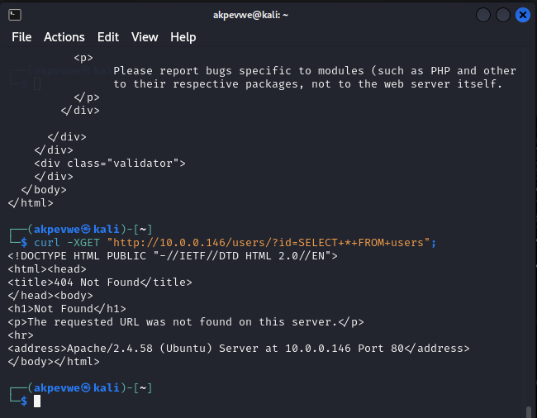
Attack Emulation
First SQL attack: success

Slide 24
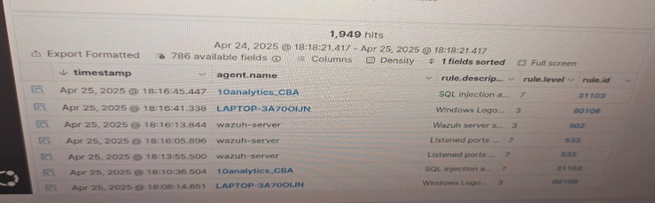
Attack Emulation
First attack: success

Slide 25
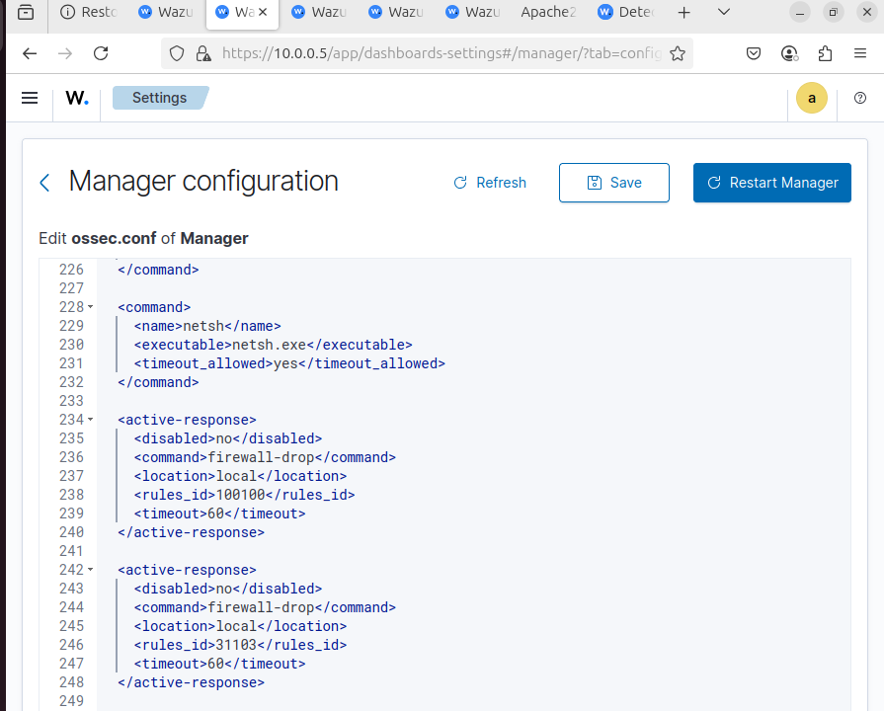

Attack Emulation
Inserted 31103 in my active response on wazuh server

Slide 26
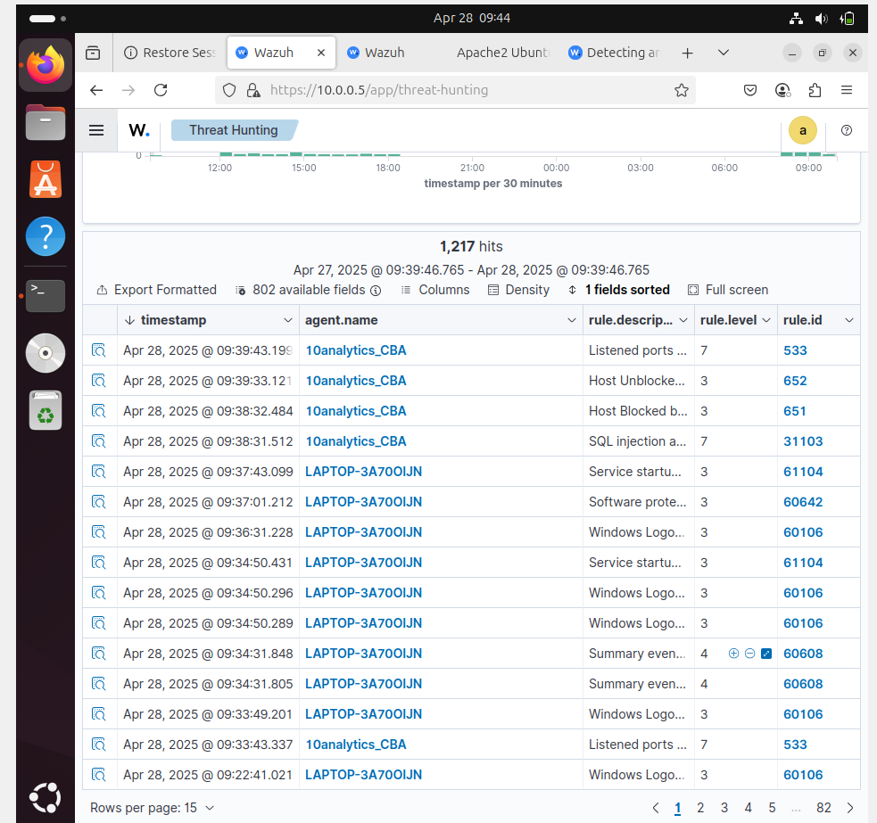
Attack Emulation
Second Attack: SQL injection detected and blocked with rule id:651

Slide 27
Active Response Actions
Detection and logging of suspicious web requests.
Temporary blocking of malicious IP via firewall rules.
Validation through Threat Hunting module in Wazuh dashboard.
Confirmed effectiveness by observing blocked access post-attack.

Slide 28
Recommendations
Expand Detection Coverage: Add monitoring for additional high-risk utilities besides Netcat.
Increase Automation: Shorten the response time by implementing faster Active Response triggers.
User Training: Regular awareness campaigns to train staff on tool misuse and incident reporting.
Red Team Exercises: Simulate real-world attacks to test and refine security posture. Log Retention and Analysis
Maintain detailed logs for forensic investigations and legal compliance.

Slide 29
Conclusion
These investigations confirmed that proactive monitoring and automated responses using Wazuh effectively detect and block security threats. Unauthorized Netcat usage was successfully identified, and malicious IPs executing attacks were automatically blocked.
Strengthening detection rules, automating responses, and enhancing user training are recommended to further improve security. Overall, the measures implemented will enhance 10ALYTICS-DC ability in threat detection and response capabilities thereby reducing the risk of unauthorized access and potential data breaches.

Slide 30
Thank You!

